Slide 1

Adaptive Software Engineering – 24CI3201
EVENT
CONNECT
Plan. Manage. Connect
Under the guidance of
G. Lavanya
Presented by: Group 10

Slide 2
S. No. | University ID | Name
1 | 2420030173 | Raavi Jahnavi
2 | 2420030211 | Maremanda Sai Kridhay Kumar
3 | 2420030556 | Sri Hansika Saraf
4 | 2420030558 | Bobbadhi Kundana Mani
Presented by: Group 10

Slide 3
ABSTRACT
EventConnect is a web-based event registration and booking system.
It provides a centralized platform for discovering and participating in events.
Users can search events, view details, book tickets, make payments and manage bookings.
Organizers can create and manage events and generate reports.
Administrators handle payment-related operations and refunds.
The system follows the Agile Scrum development approach.

Slide 4
EXISTING MODEL
Existing Approach | Limitation
Event information on different platforms | Users need to search across multiple sources
Separate registration and booking processes | User experience can be fragmented
Limited booking tracking | Difficult for users to manage all bookings
Limited organizer tools | Event management can require multiple tools
Separate reports and records | Difficult to get centralized insights
Limited integration between modules | Registration, booking and payment may not be connected

Slide 5
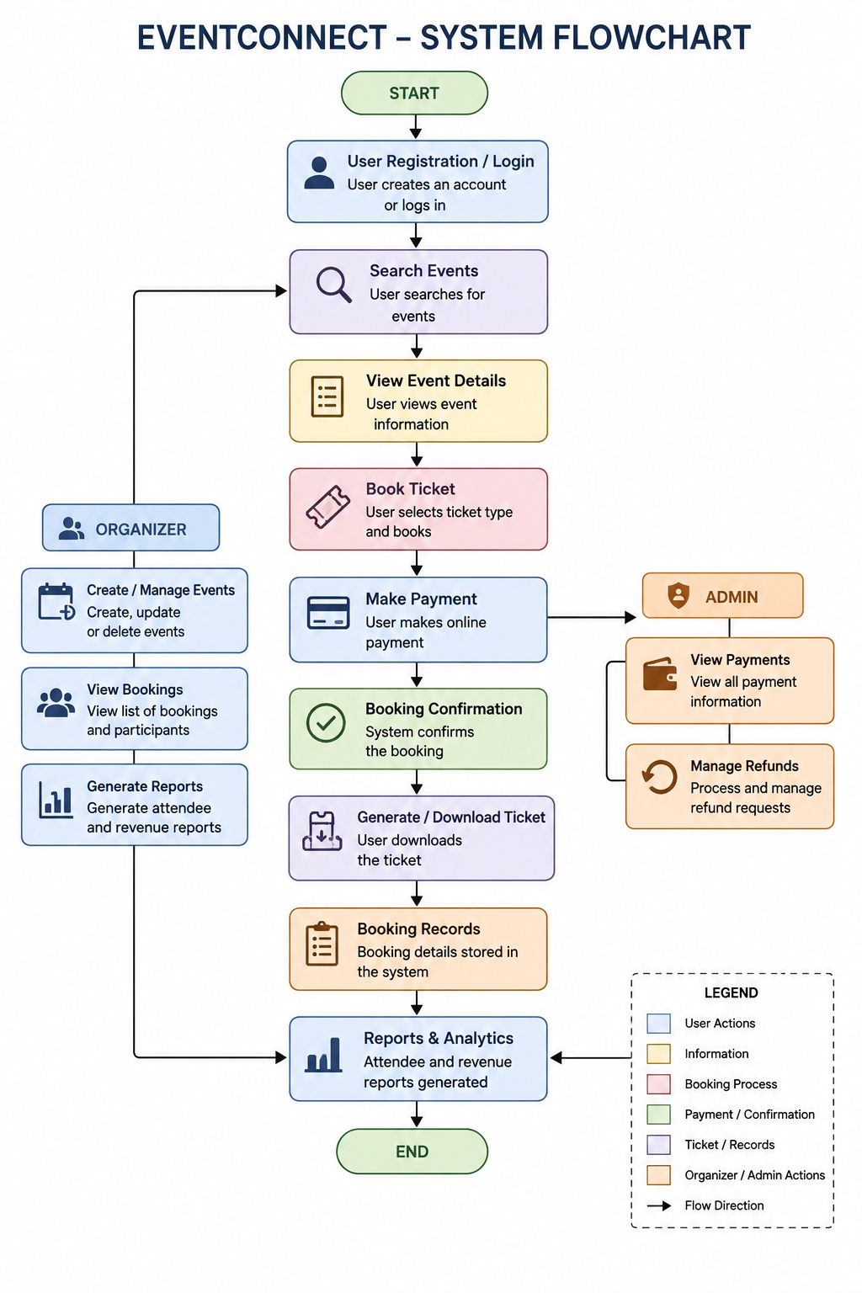
PROPOSED MODEL
EventConnect provides a centralized platform that connects event discovery, registration, ticket booking, payments, and reporting.
Key Features:
User Registration & Login
Event Search & Details
Ticket Booking & Cancellation
Online Payment
Booking Confirmation & Ticket Download
Attendee & Revenue Reports
Refund Management

Slide 6
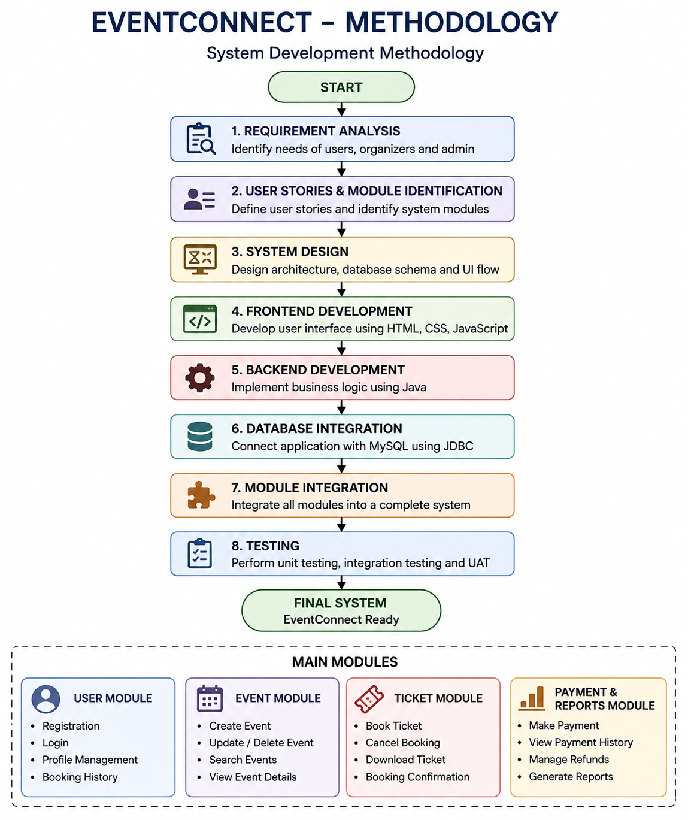
METHODOLOGY
System Development Methodology
01
The EventConnect system is developed by integrating its major modules into one complete event platform.
02
Main Modules
User Module → Registration, login, profile
Event Module → Create, update, search events
Ticket Module → Booking, cancellation, tickets
Payment & Reports Module → Payments, refunds, reports

Slide 7
MODULES
User Registration
User Login
Update Profile
Reset Password
View Booked Events
USER MANAGEMENT

Slide 8
MODULES
Create Event
Update Event
Delete Event
Search Events
View Event Details
EVENT MANAGEMENT

Slide 9
MODULES
Book Ticket
Cancel Booking
Booking History
Download Ticket
Booking Confirmation
TICKET
BOOKING

Slide 10
MODULES
Make Payment
Payment History
Generate Attendee Reports
Generate Revenue Reports
Refund Management
PAYMENTS & REPORTS

Slide 11
DIFFERENT USERS
USER
ORGANIZER
ADMIN
Register and login
Search and view events
Book and cancel tickets
Make payments
View booking history
Download tickets
Create events
Update events
Delete events
View bookings
Generate attendee reports
Generate revenue reports
View payment information
Manage refunds
Handle administrative operations

Slide 12
PROCESS MODEL
AGILE
Incremental development
Continuous testing
Regular feedback
Easy progress tracking
Better team collaboration
Features can be improved after each sprint

Slide 13
TECHNICAL ASPECTS
FRONTEND:
React
HTML/CSS
JavaScript
Rest APIs
Forms and Event Pages
BACKEND:
Java + Spring Boot
Object-Oriented Programming
Business Logic
User Management
Event Management
Booking & Payment Processing
BACKEND: Spring Data JPA
MySQL
User Data
Event Data
Booking Records
Payment Records
POSTMAN-test and verify
Docker & Kubernetes:
Docker containerizes the application and its dependencies
Kubernetes manages and deploys containers
Supports scalability and reliable application availability
GIT-HUB

Slide 14
CONCLUSION
EventConnect provides a centralized event registration and booking platform.
It integrates event discovery, ticket booking, payments and reporting.
It provides different functionalities for users, organizers and administrators.
The modular structure makes the system easier to develop and maintain.
Agile Scrum enables incremental development, continuous testing and improvement.

Slide 15
THANK YOU

